Slide 1
Behavioral Patterns part -I
Emre Kaplan, Ph.D.

Slide 2
Behavioral Patterns
Behavioral patterns are concerned with algorithms and the assignment of responsibilities between objects.
Behavioral patterns describe not just patterns of objects or classes but also the patterns of communication between them.
These patterns characterize complex control flow that's difficult to follow at run-time. They shift your focus away from flow of control to let you concentrate just on the way objects are interconnected.
Behavioral object patterns use object composition rather than inheritance.
Source: Erich Gamma, Richard Helm, Ralph Johnson, and John Vlissides. 1995. Design Patterns: Elements of Reusable Object-Oriented Software. Addison-Wesley Longman Publishing Co., Inc., Boston, MA, USA.

Slide 3
Behavioral Patterns
Behavioral Patterns
Template Method
Null Object
Observer
Iterator
State
Mediator
Strategy
Command
Visitor
Chain of Responsibility
Memento
Dependency Injection

Slide 4
Template Method
Intent
Define the skeleton of an algorithm in an operation, deferring some steps to subclasses.
Template Method lets subclasses redefine certain steps of an algorithm without changing the algorithm's structure.
Implement an algorithm in a method, deferring the definition of some steps of the algorithm so that other classes can redefine them.
Source: Freeman, E., Robson, E., Sierra, K., & Bates, B. (2004). Head First design patterns. Sebastopol, CA: O'Reilly.
Source: Erich Gamma, Richard Helm, Ralph Johnson, and John Vlissides. 1995. Design Patterns: Elements of Reusable Object-Oriented Software. Addison-Wesley Longman Publishing Co., Inc., Boston, MA, USA.

Slide 5
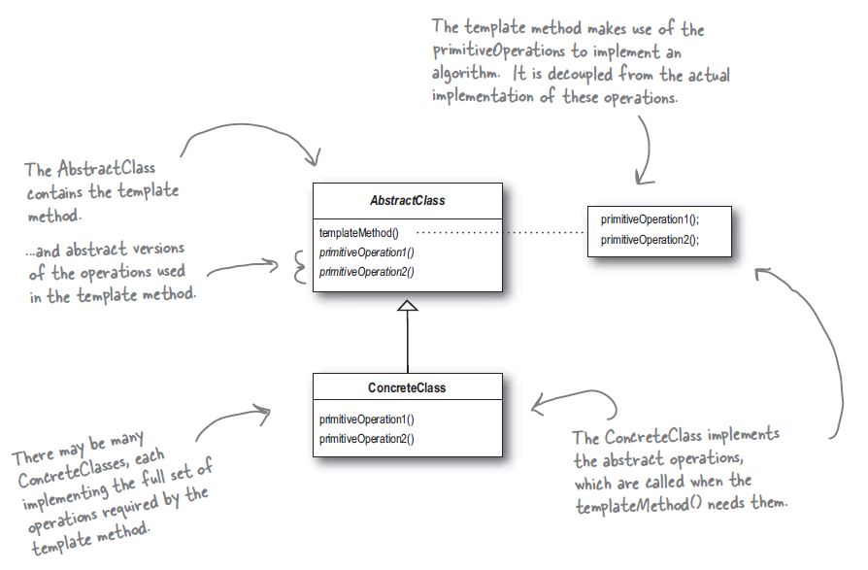
Structure
Source: Freeman, E., Robson, E., Sierra, K., & Bates, B. (2004). Head First design patterns. Sebastopol, CA: O'Reilly.

Slide 6
Template Method
Create a (final) method that delegates to others
Client overrides the other methods
Template method calls the others in the proper order
Source: Freeman, E., Robson, E., Sierra, K., & Bates, B. (2004). Head First design patterns. Sebastopol, CA: O'Reilly.

Slide 7
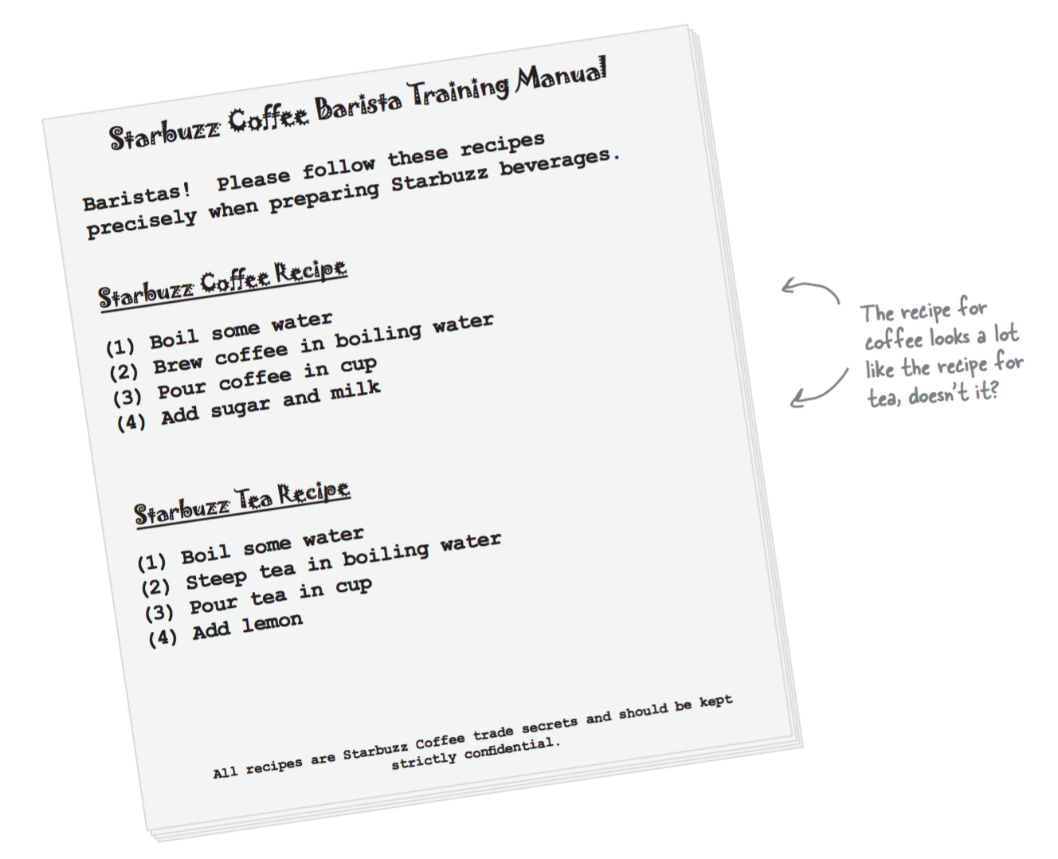
Template Method Sample Code

Slide 8
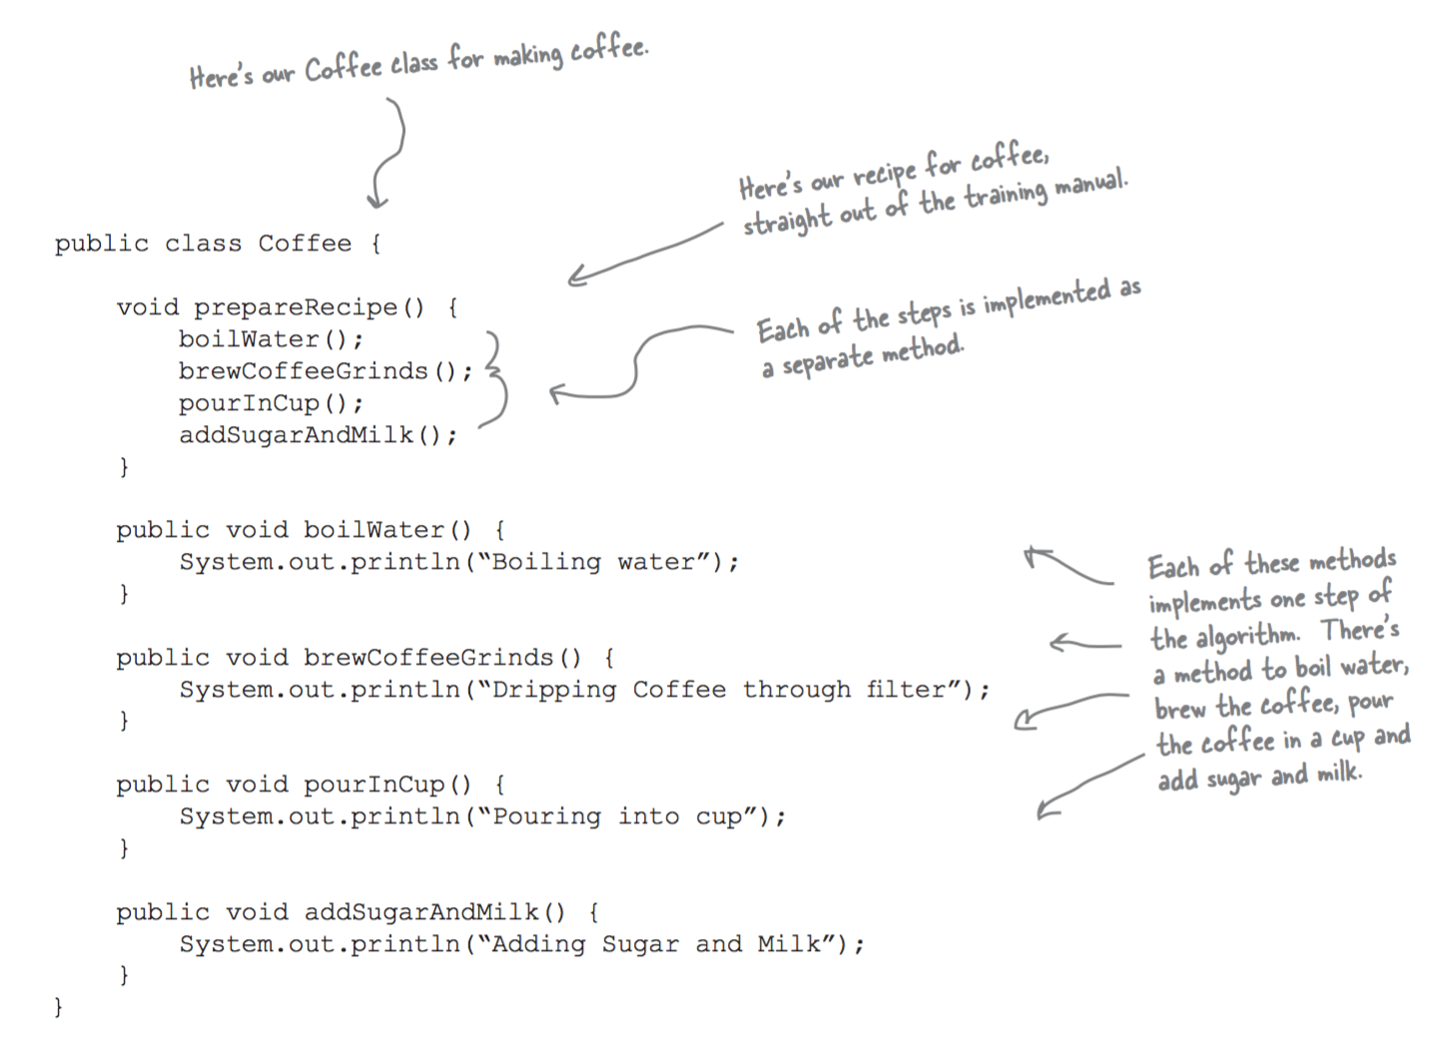
Template Method Sample Code

Slide 9
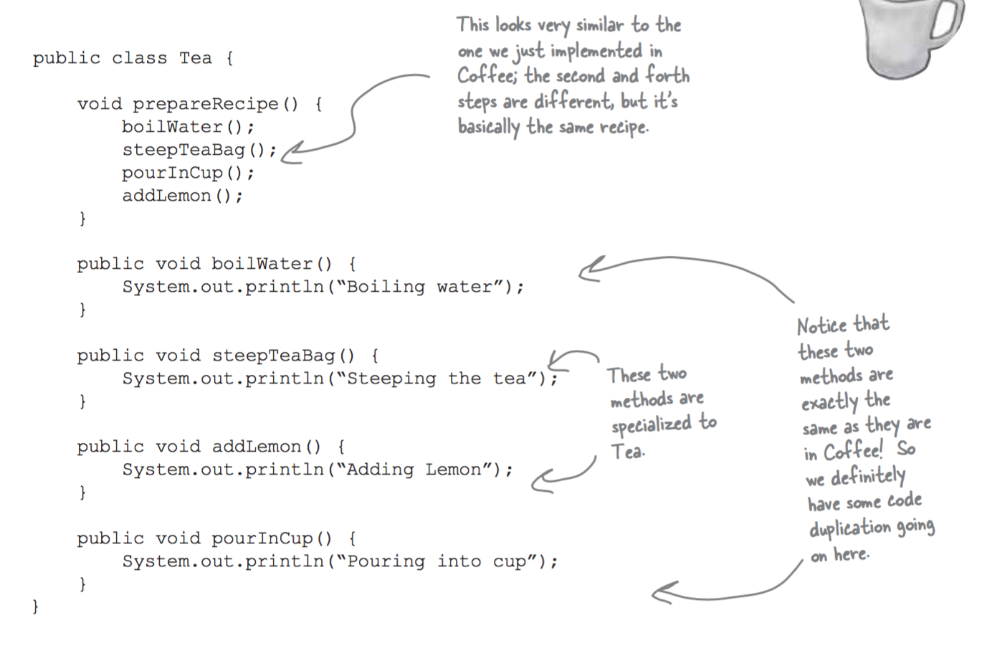
Template Method Sample Code

Slide 10
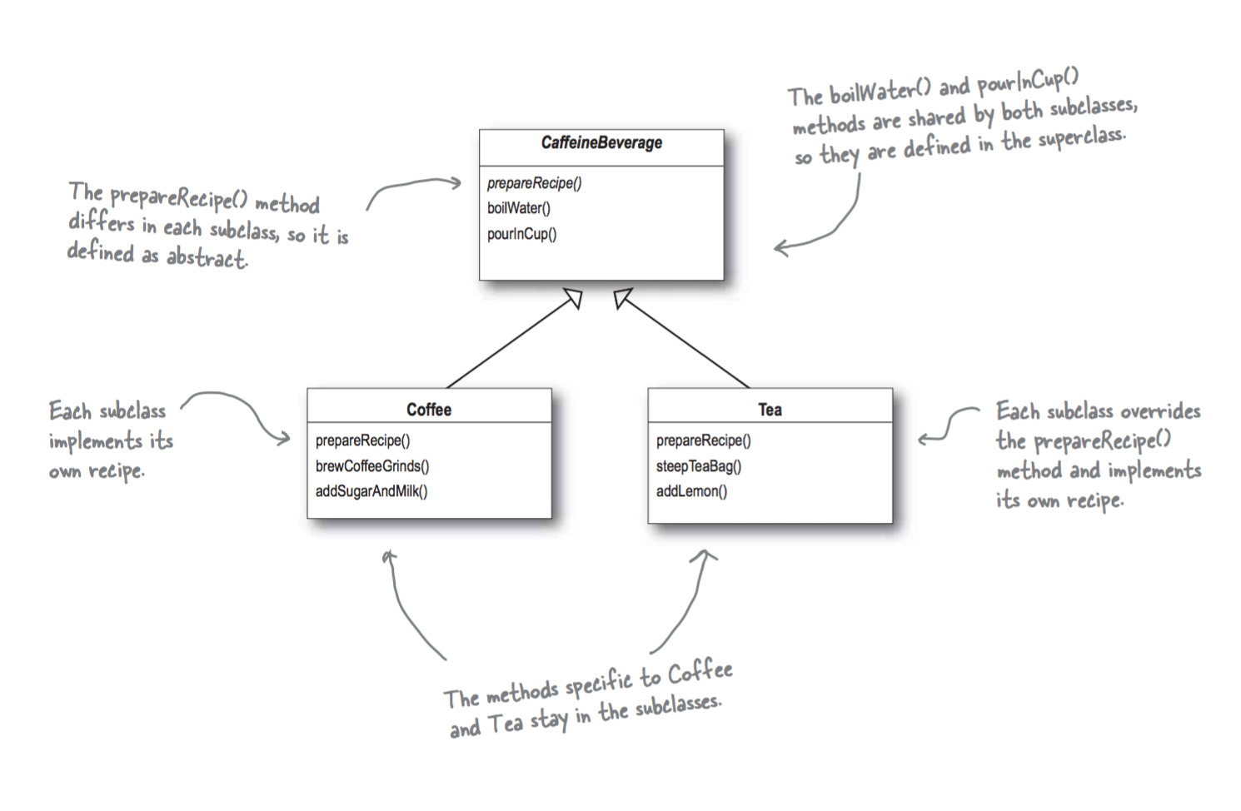
Template Method Sample Code

Slide 11
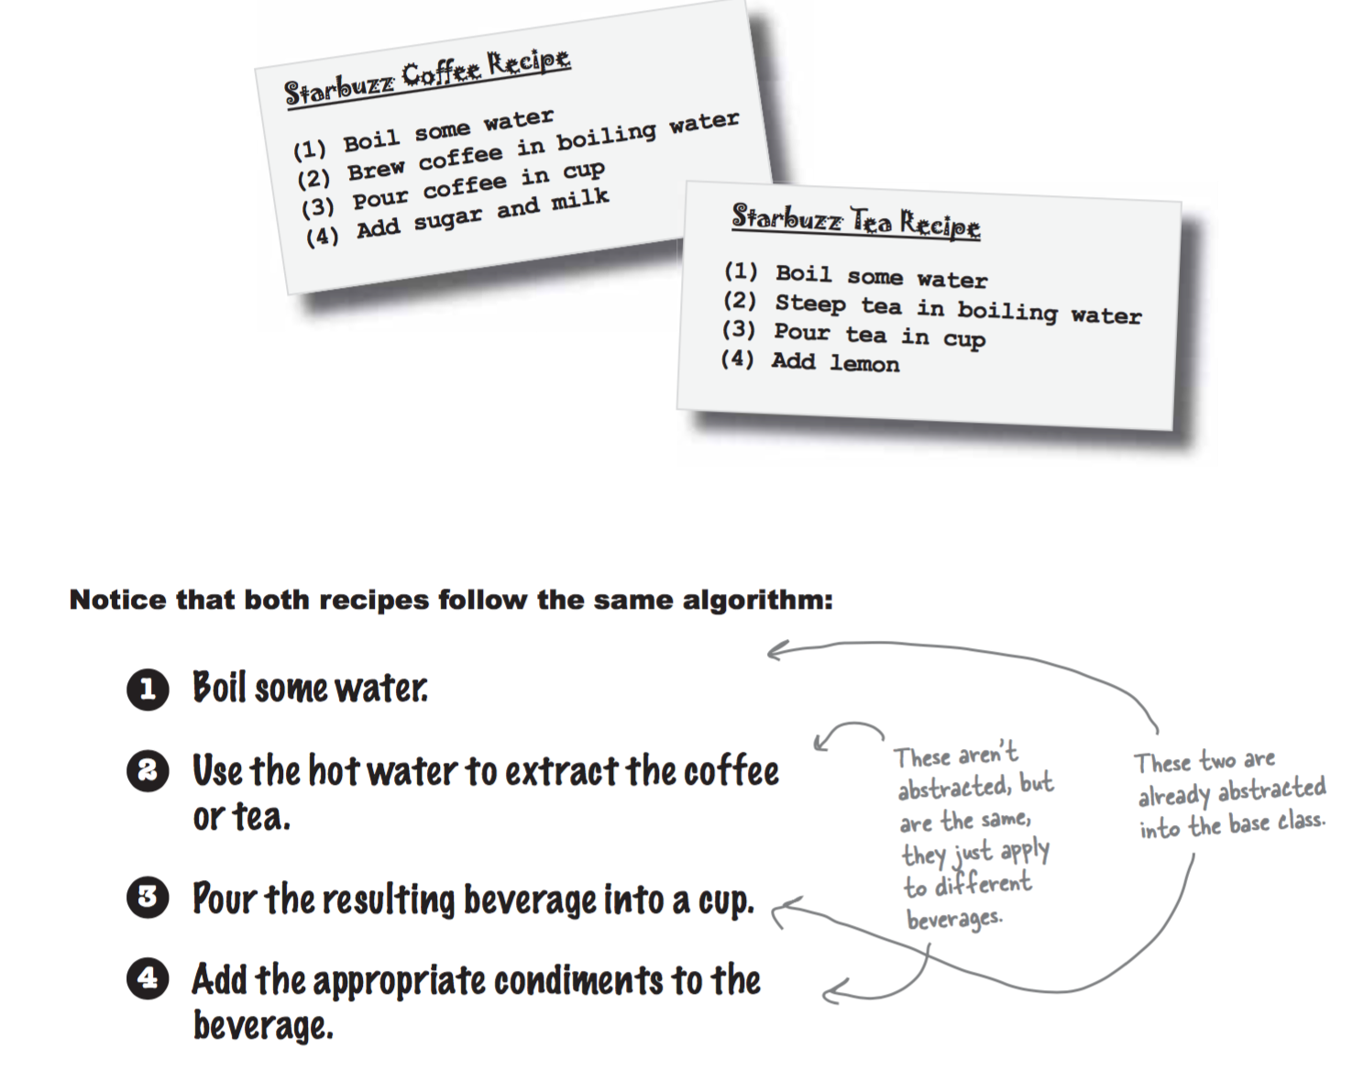
Template Method Sample Code

Slide 12
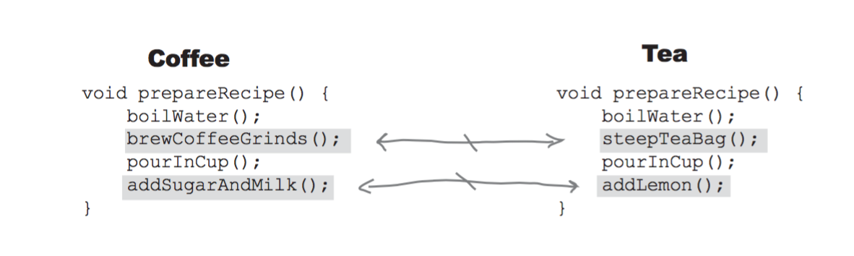
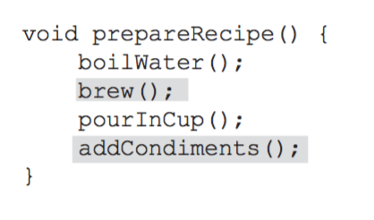
Template Method Sample Code

Slide 13
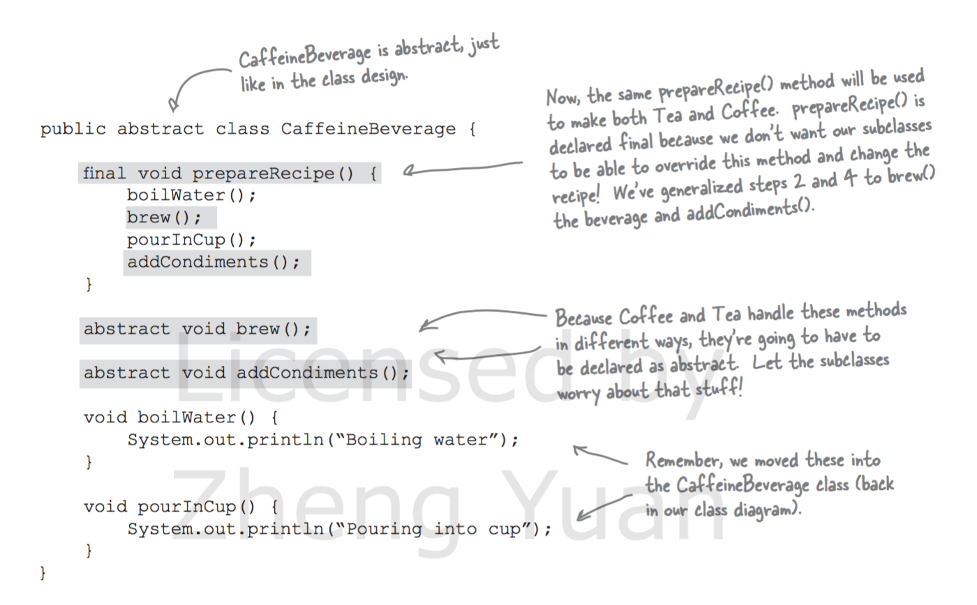
Template Method Sample Code

Slide 14
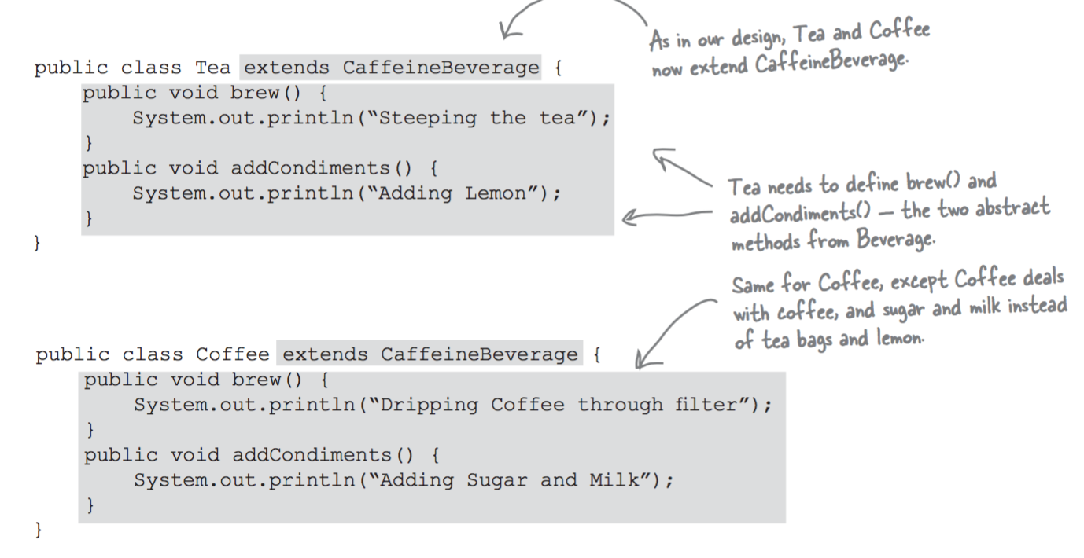
Template Method Sample Code

Slide 15
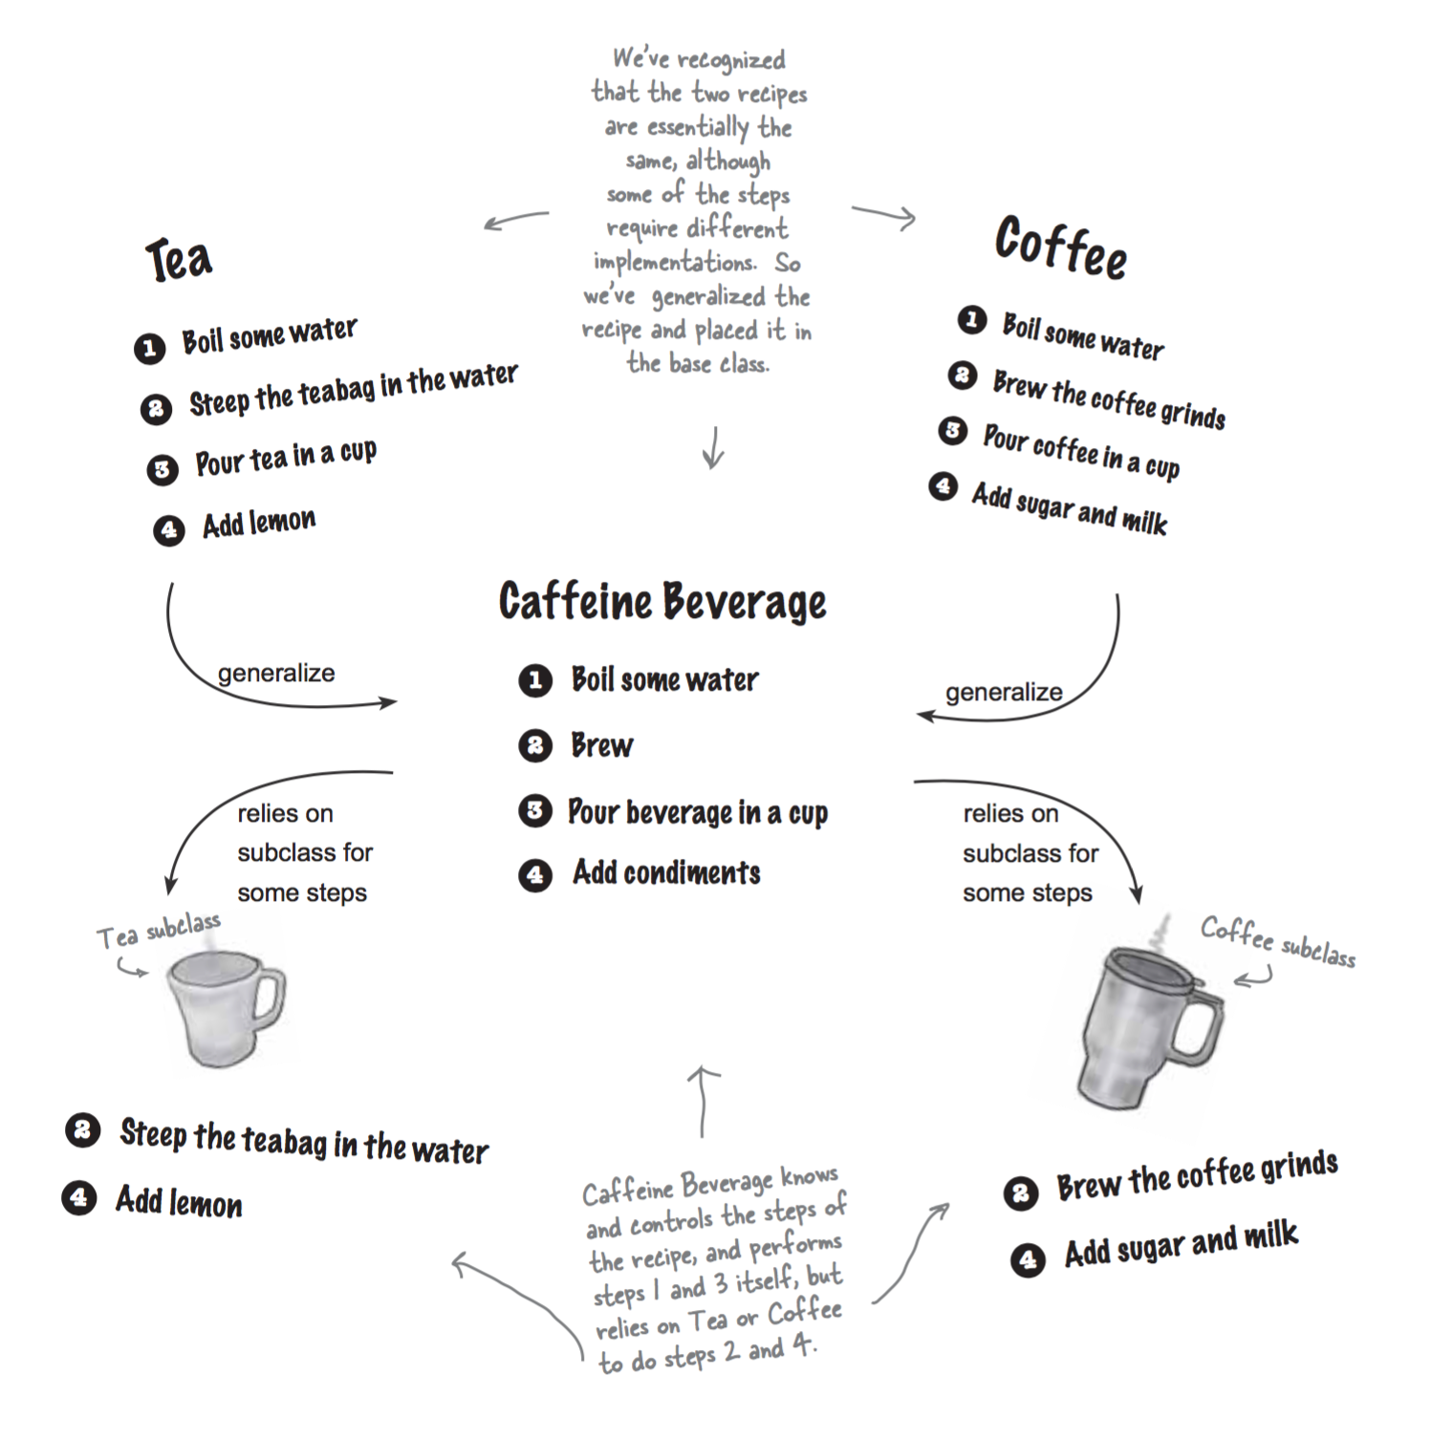
Template Method Sample Code

Slide 16
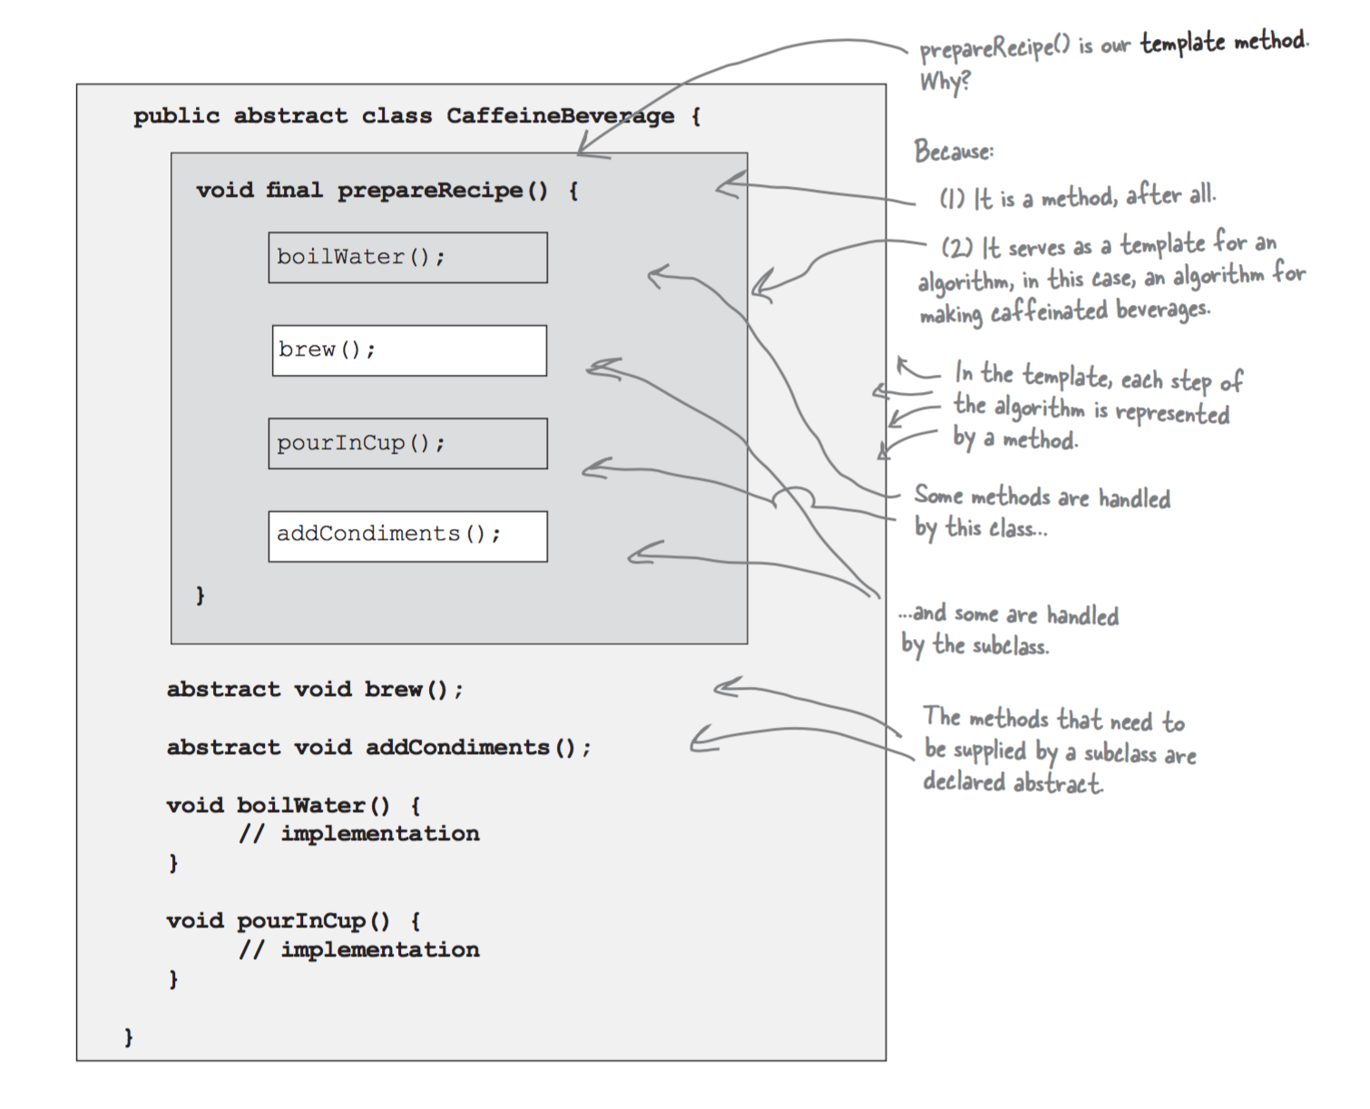
Template Method Sample Code

Slide 17
Applicability
The Template Method pattern should be used
to implement the invariant parts of an algorithm once and leave it up to subclasses to implement the behavior that can vary.
when common behavior among subclasses should be factored and localized in a common class to avoid code duplication.

Slide 18
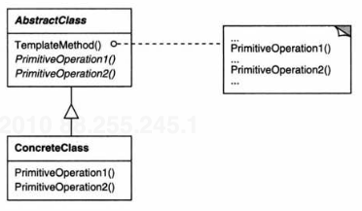
Template Method Structure
Source: Erich Gamma, Richard Helm, Ralph Johnson, and John Vlissides. 1995. Design Patterns: Elements of Reusable Object-Oriented Software. Addison-Wesley Longman Publishing Co., Inc., Boston, MA, USA.

Slide 19
Consequences
Code reuse
factor out common behavior in library classes.
Inversion of control
Hollywood principle
This refers to how a parent class calls the operations of a subclass and not the other way around.

Slide 20
Null Object Pattern
In most object-oriented languages, such as Java or C#, references may be null.
references need to be checked to ensure they are not null before invoking any methods
Instead of using a null reference to convey absence of an object (for instance, a non-existent customer), one uses an object which implements the expected interface,
but whose method body is empty.
The advantage of this approach over a working default implementation is that a Null Object is very predictable and has no side effects: it does nothing.

Slide 21
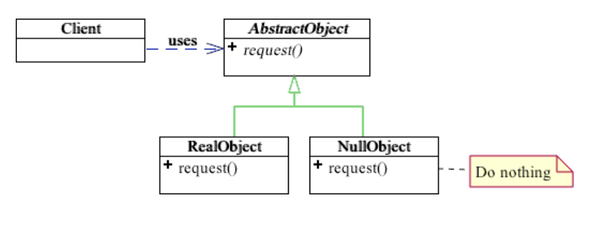
Null Object Structure

Slide 22
Null Object Pattern
Intent
Provide a surrogate for another object that shares the same interface but does nothing.
Encapsulates the implementation decisions of how to “do nothing” and hides those details from the collaborators.
Motivation
Employee e = DB.getEmployee("Bob");
if (e != null && e.isTimeToPay(today))
e.pay();
A null object is often implemented as a Singleton. Why?
Notes:
A null object should be implemented as a Singleton. Because many copies of this no-effect objects consume memory and slow down the operation. Iterating over many null objects vs calling same null object’s.

Slide 23
Null Object Pattern
Employee e = DB.getEmployee("Bob");
if (e != null && e.isTimeToPay(today))
e.pay();
Short-cut evaluation
Throw exception? Try-catch?

Slide 24
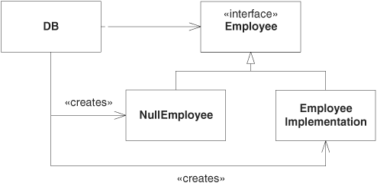
Null Object Pattern
Employee e = DB.getEmployee("Bob");
if (e.isTimeToPay(today))
e.pay();

Slide 25
Consequences
The advantage of this approach over a working default implementation is that a Null Object is very predictable and has no side effects:
it does nothing.
A null object is often implemented as a Singleton.
“If you have two versions of null objects, they should be identical, why waste memory to have same nothingness repeated”.
For equality checks – Each null object can be compared by reference.
*42 minutes into the Coding Blocks Episode 16 by Michael Outlaw

Slide 26
Consequences
Lets you add observers without modifying the subject or other observers.
Abstract coupling between Subject and Observer.
Support for broadcast communication.
Unexpected/spurious updates.

